Slide 1

Industrial Control Systems Stephen Dunlap, CISSP
stephen.dunlap.ctr@afit.edu
sdunlap@appliedres.com
This briefing, presentation, or document is for information only.
No US Government commitment to sell, loan, lease, co-develop
or co-product defense articles or provide defense services is implied or intended

Slide 2
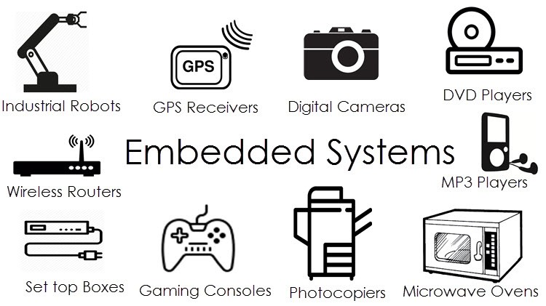
Cyber-physical Systems

Slide 3
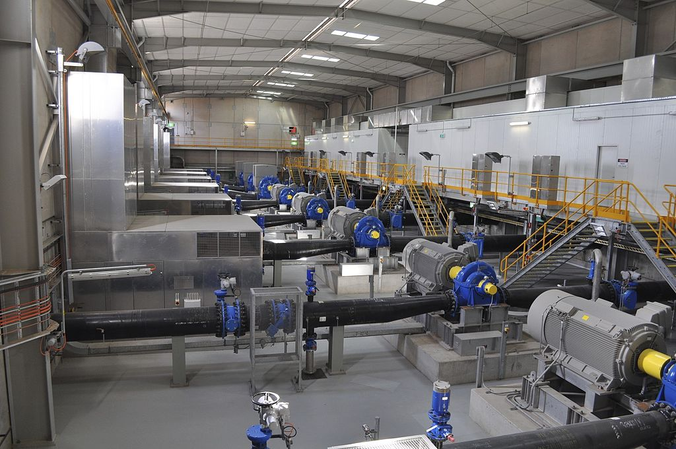
Operational Technology
Source: https://commons.wikimedia.org/wiki/File:Transfer_Pump_Station.jpg
Notes:
UNCLASSIFIED
https://commons.wikimedia.org/wiki/File:Transfer_Pump_Station.jpg
This is what OT systems look like
Instead of an antistatic lab coat, you wear a hard-hat and steel-toed shoes. ICS must function in environments that are electrically noisy, dirty, at temperature extremes, etc.
Operational technology (OT) is hardware and software that detects or causes a change through the direct monitoring and/or control of physical devices, processes and events in the enterprise.
Source: https://en.wikipedia.org/wiki/Operational_Technology
OT's modernization through IT integration brings with it the required consideration of security. Many operational technology systems were never designed for remote accessibility and, as a result, the risks of connectivity were not considered. Such systems may not be regularly updated. The vulnerabilities of OT systems can leave organizations and critical infrastructure at risk of industrial espionage and sabotage.
What is it OT convergence?
IT/OT convergence is the integration of information technology (IT) systems used for data-centric computing with operational technology (OT) systems used to monitor events, processes and devices and make adjustments in enterprise and industrial operations.
Operational Technology is utilized in many sectors and environments, such as:
Oil & Gas
Power and Utilities
Chemicals manufacturing
Water treatment
Waste management
Transportation
Scientific experimentation
Historically, ICS were physically isolated or air-gapped from the outside world. Now systems are linked into the corporate WAN and Internet to allow process monitoring and maintenance for off-site groups.
Control engineers, technicians, operators typically are not skilled in cyber-security. Conversely, IT professionals are not skilled in process control.
– They have different, and sometimes conflicting, goals and management in the corporate structure.
It is difficult to make a business case for cyber-security, though this is improving. The perception is no attacks mean no problems.
Source: https://surveillance-security-camera.blogspot.com/2017/02/detecting-plc-malware-in-industrial.html
UNCLASSIFIED

Slide 4
What is CI?
Chemical
Commercial Facilities
Communications
Crit. Manufacturing
Dams
Defense Industrial
Emergency Services
Energy
Financial Services
Food & Agriculture
Govt. Facilities
Healthcare
Information Tech
Nuclear
Transportation
Water & Wastewater
Public or private?

Slide 5
Military Assets
Building Automation – HVAC, access control
Power – distribution, backup generation, conservation
Water – treatment and waste
Security – perimeter defenses, cameras
Transportation – traffic lights, street lights
Emergency Services – police, fire, EMS
Flight Line – lights, communications
Weapon Systems
Fueling Systems

Slide 6
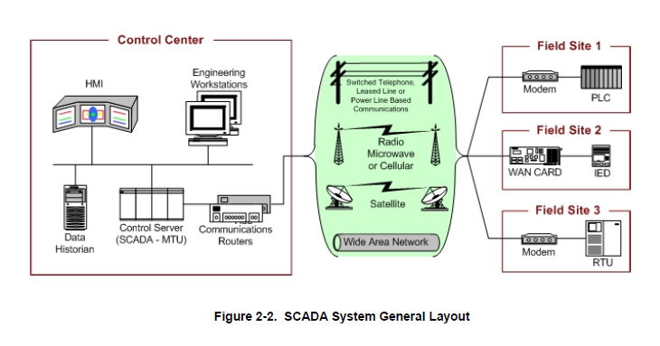
Industrial Control Systems
Source: NIST Special Publication 800-82 r2, Guide to Industrial Control Systems (ICS) Security.

Slide 7
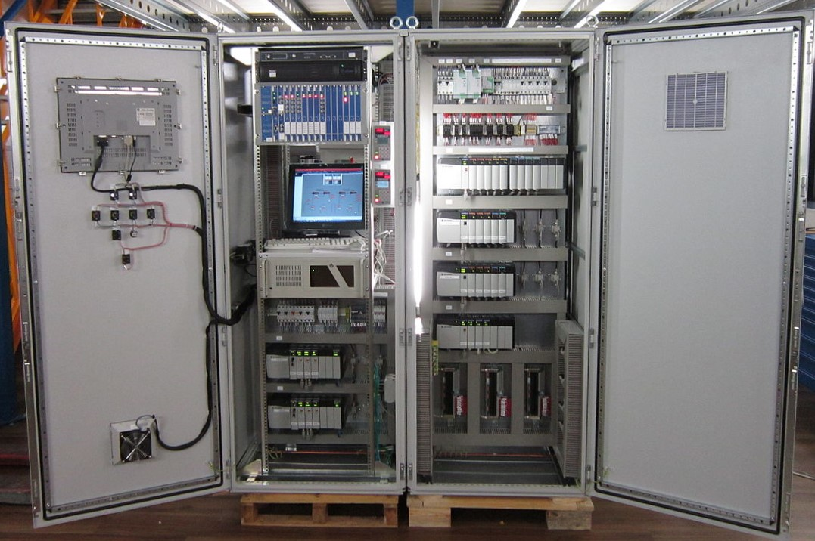
Field Sites
Image: https://www.reeng.com.au/products/control-systems/

Slide 8
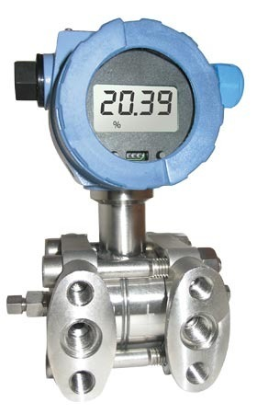
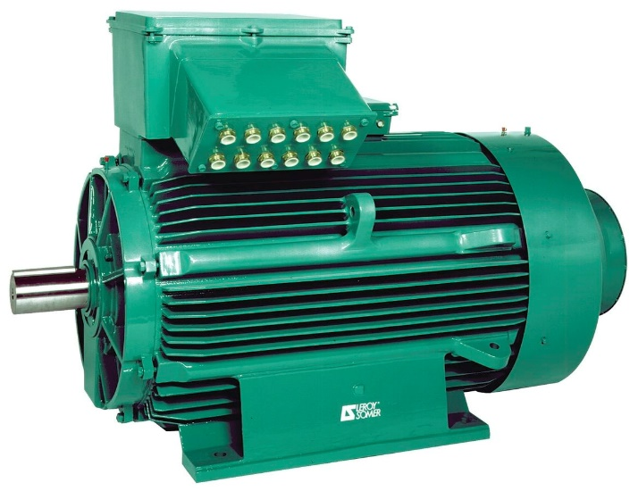
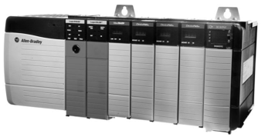
Field Sites
Digital:
0 – 24 VDC
0 – 110 VAC
Analog:
0 – 10 VDC
0 – 20 mA
4 – 20 mA

Slide 9
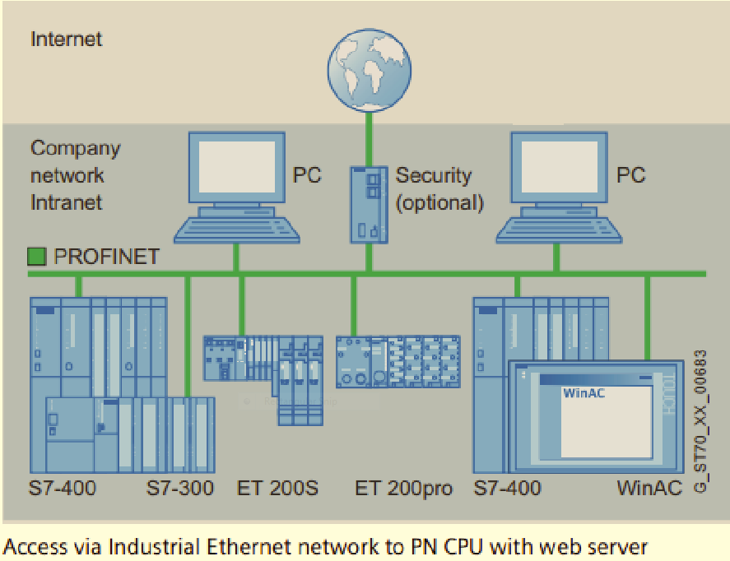
The Problem
???

Slide 10

EMCS
Source: Max Cornelisse

Slide 11
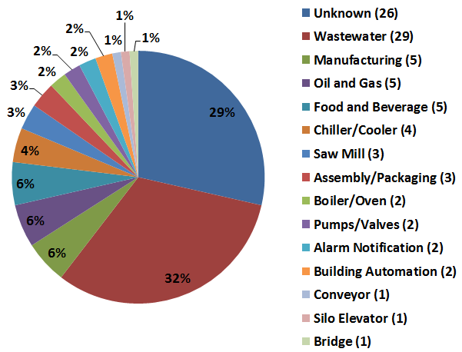
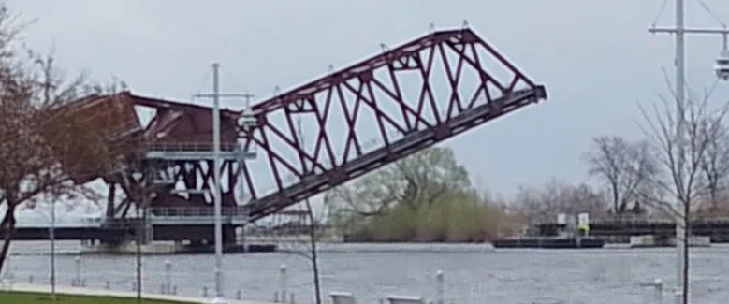
Internet Facing Devices

Slide 12

Bridge PLC
Source: Max Cornelisse

Slide 13
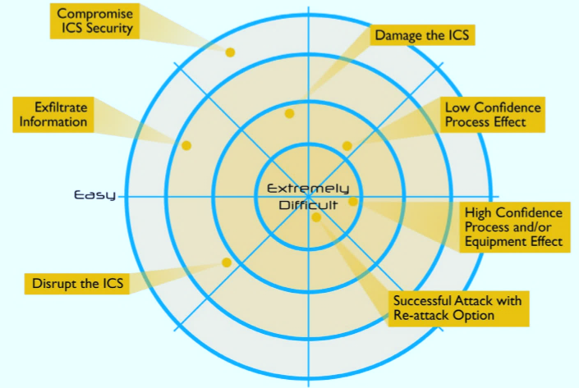
ICS Attack Difficulty

Slide 14
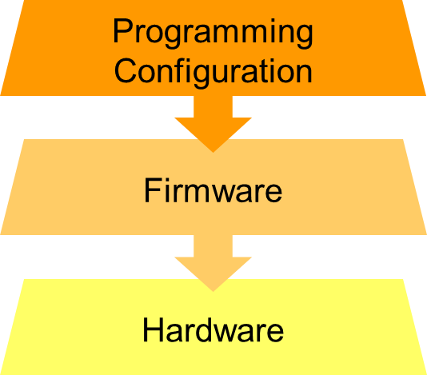
Targets
Source: NIST Special Publication 800-82 r2, Guide to Industrial Control Systems (ICS) Security.

Slide 15
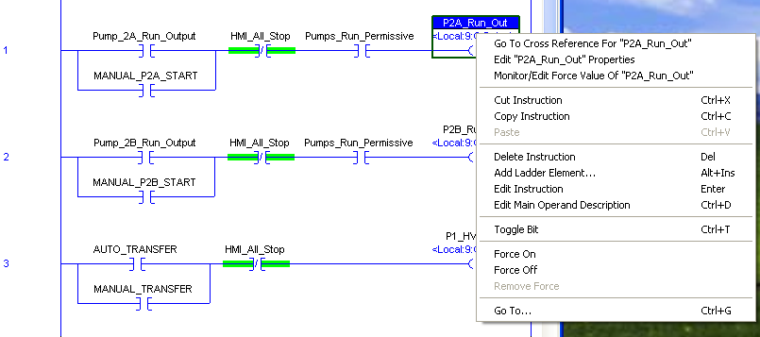
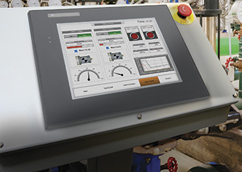
Vendor Tools

Slide 16
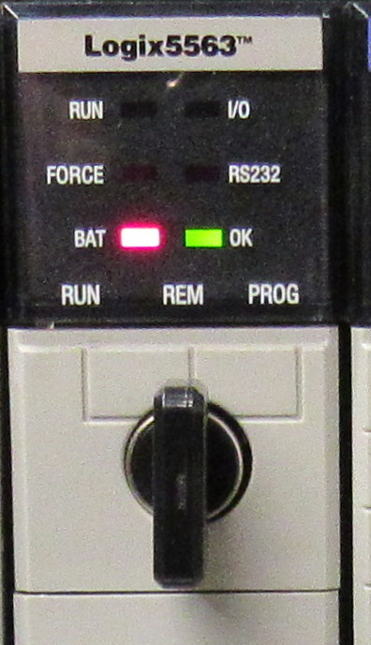
Easy Defense

Slide 17
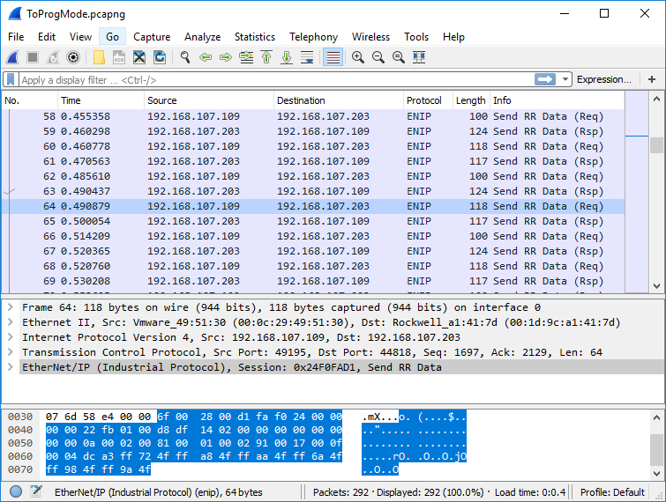
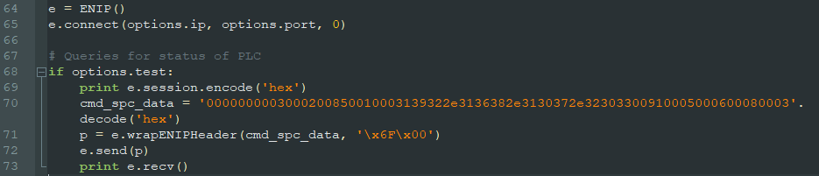
Build Your Own Tools

Slide 18


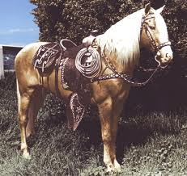
Firmware Implants
Deployment
Triggers
Payloads

Slide 19
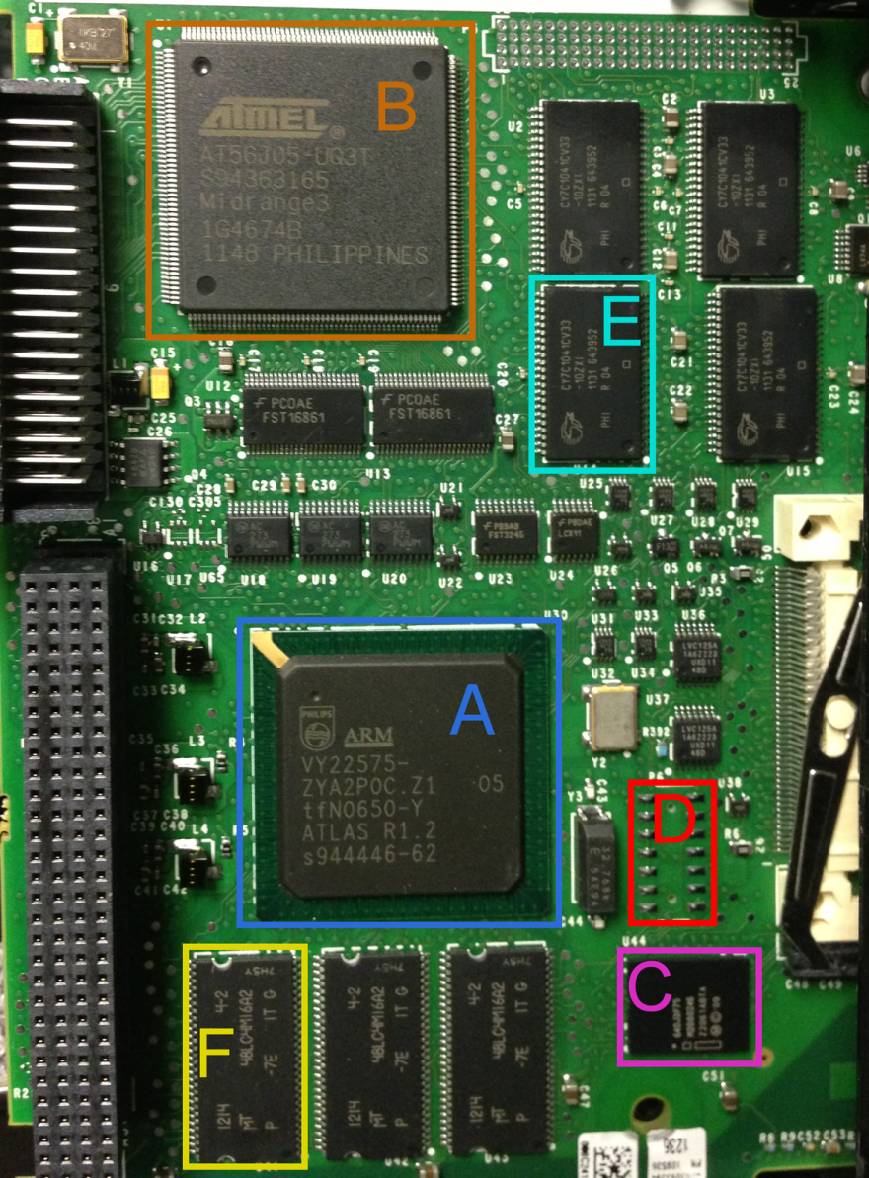
Why Firmware Implants
Full control over device
Bypass security mechanisms
Include backdoors
Self propagation
Impossible to detect
Impossible to clean device
Unless you use physical access

Slide 20
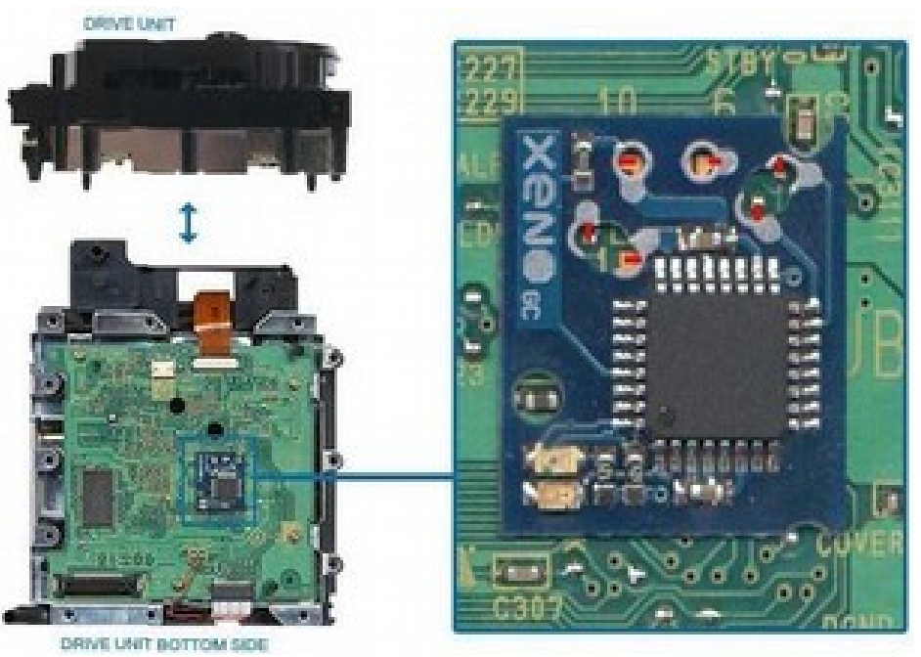
Hardware

Slide 21
Defense – NIST Framework
Identify – Passive monitoring
Protect – Isolation/segmentation
Detect – Deep packet inspection
Respond – Manual operation
Recover – Bring back automation

Slide 22

Questions
stephen.dunlap.ctr@afit.edu
sdunlap@appliedres.com

